Slide 1
Online Bidder Enrollment

Slide 3
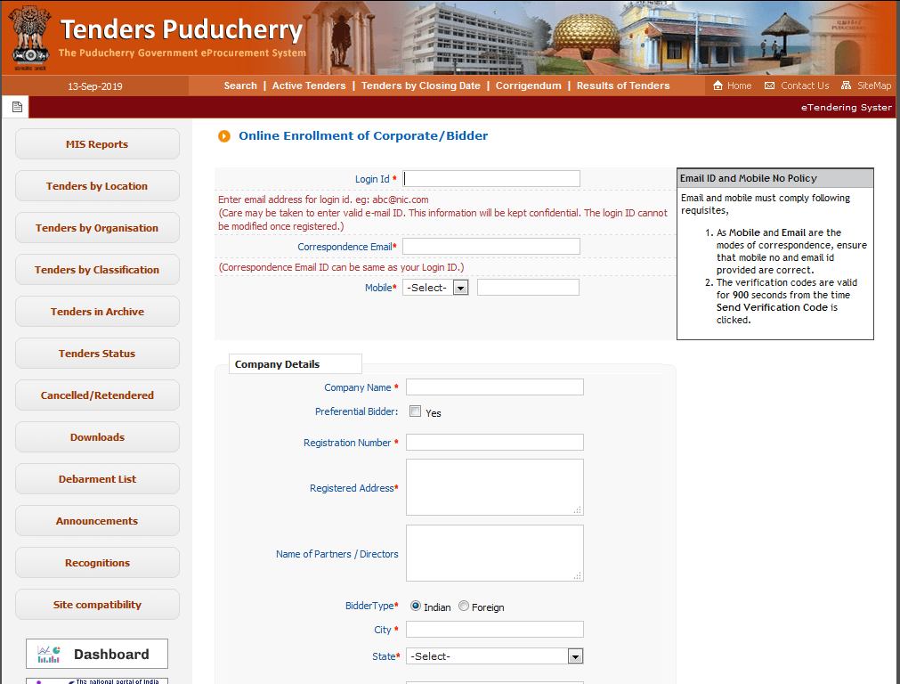
Fill all the information

Slide 4
Fill Company Details

Slide 5
Fill Contact Details
Enter the Captcha
Click on Submit Button

Slide 6
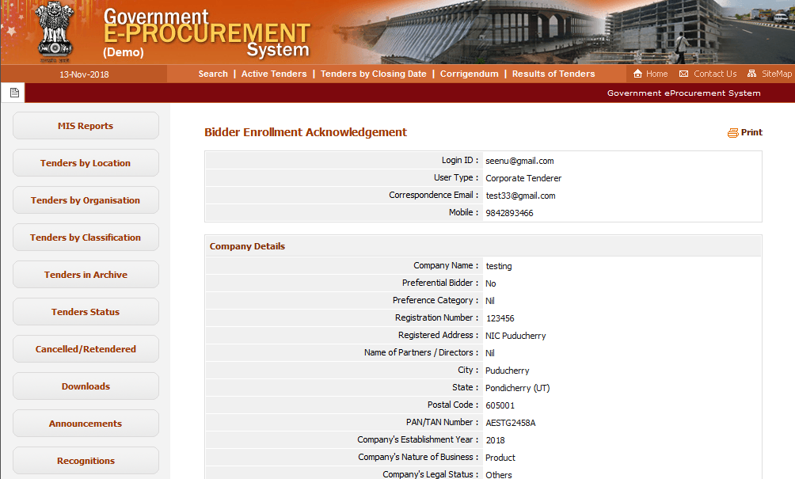
Verify all the information

Slide 7
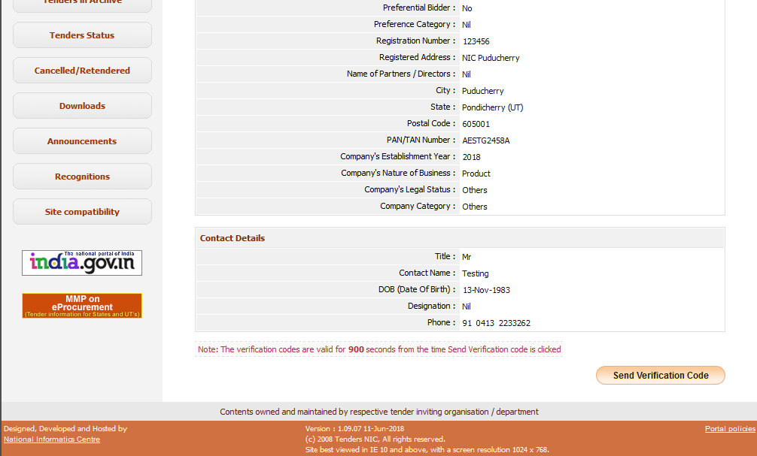
Click on Send Verification Code to Proceed further

Slide 8
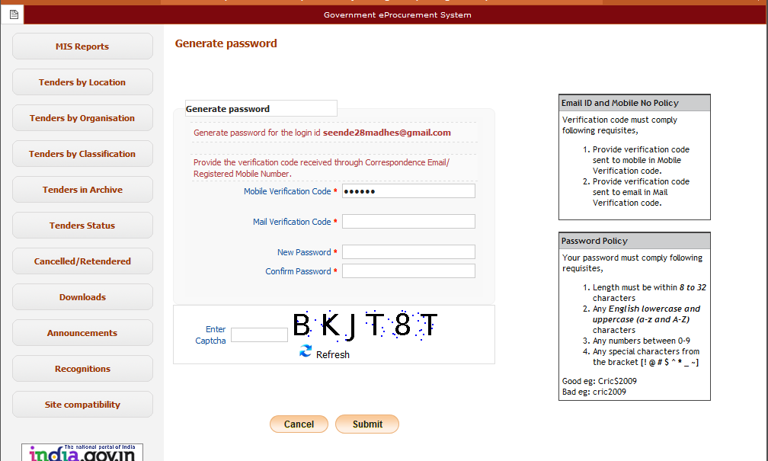
Fill the Mail and Mobile verification code
Fill New password as per policy , Click on Submit button

Slide 9
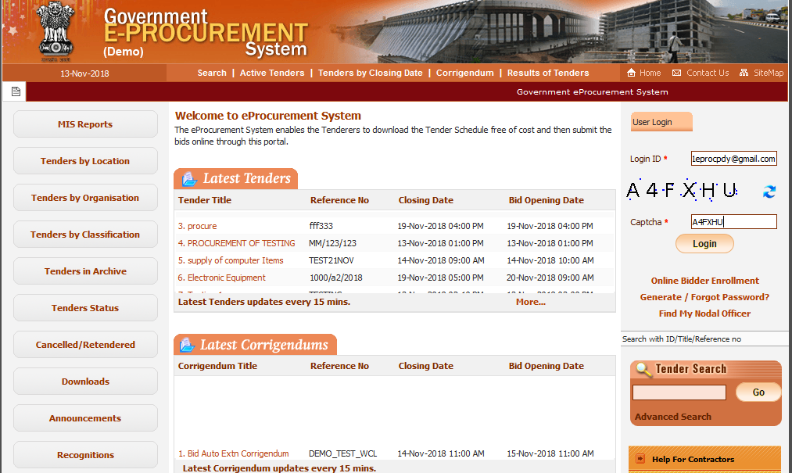
Fill User ID , Captcha and Click on Login button

Slide 10
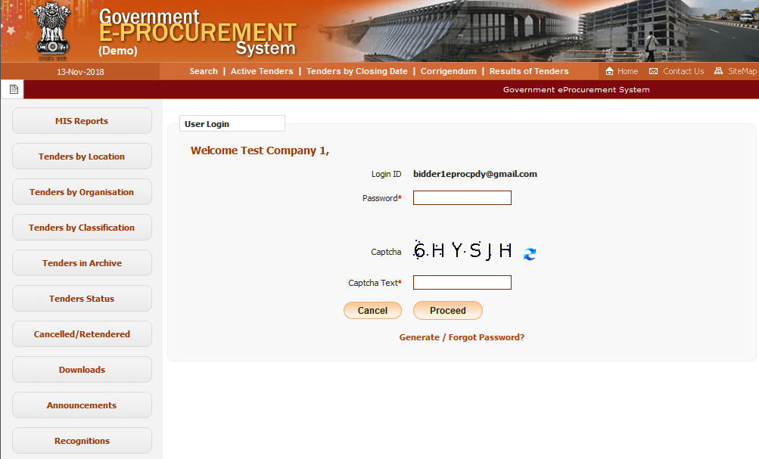
Fill Password, Captcha and Click on Proceed button

Slide 17
Online Bidder
Enrollment Ends

