Slide 1
Tender Creation

Slide 2
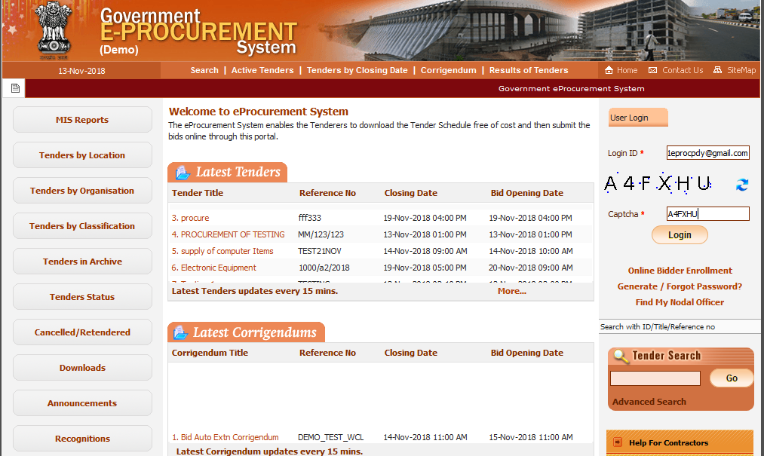
Fill Dept user ID, Captcha and Click on Login button

Slide 3
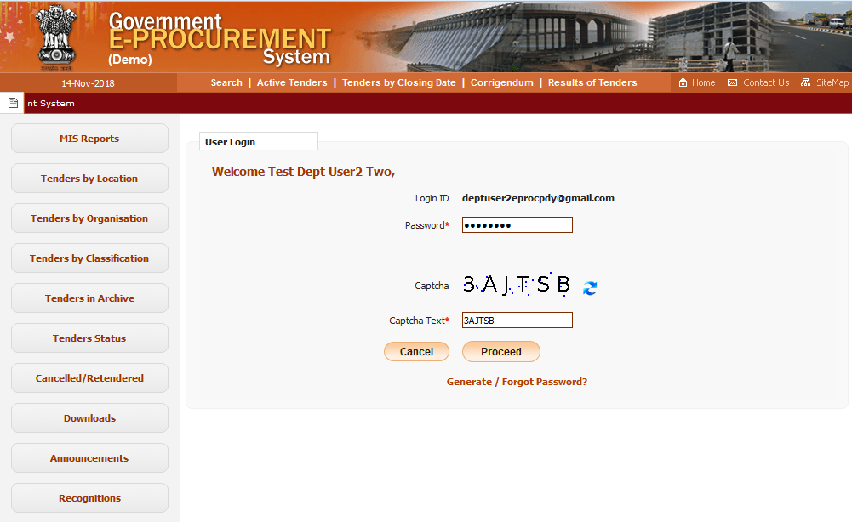
Fill Password, Captcha and Click on Proceed button

Slide 4
Click for Second level Authentication

Slide 6
Here Click to create New tender

Slide 7
Click this button to create new tender in bottom of the page

Slide 11
1.(Fee + Pre Qual + technical bid +Financial bid)
2.(Fee + Pre Qual + technical bid) / (Financial bid)
3.(Fee) / (Pre Qual + technical bid) / (Financial bid)
4.(Fee) / (Pre Qual) / (technical bid) / (Financial bid)

Slide 14
Fill the all required details and click on Next button

Slide 15
Click this Icon to add Technical documents

Slide 19
Click this Icon to add Financial documents

Slide 21
Each Cover Documents Count

Slide 22
Click this button to upload NIT document

Slide 24
Click this link to verify the document

Slide 26
f
Click this button to proceed next step

Slide 27
Fill the required details

Slide 28
Click Next button to proceed
Click Cancel button to exit the process

Slide 29
Fill the tender fee details

Slide 30
Fill the EMD fee details
Click Next button to proceed

Slide 31
Fill the Critical date details
Click Next button to proceed

Slide 32
Select the Openers Names
Click Submit button to proceed

Slide 33
Click this button to Upload BOQ

Slide 34
Here download the Predefined BOQ templates

Slide 35
Preparation of BOQ

Slide 36
Select the BOQ File

Slide 37
Enter the DSC Password

Slide 39
Click Verify Button to verify the BOQ

Slide 40
After verify the file check and click on Save button

Slide 41
Click on Next button

Slide 42
Select OID file to upload and Click Next Button

Slide 43
Full Details of Tender - I

Slide 44
Full Details of Tender - II

Slide 45
Full Details of Tender - III
Select I Agree check box and Click on “Send to Publish” Button

Slide 46
Select Publish Tender Tab

Slide 47
Select View to Open tender

Slide 48
Click “Publish Tender” button to publish the tender

Slide 49
Successful Message displayed

Slide 50
Select Published Tender Tab

Slide 51
Published tender displayed in the list

Slide 52
Tender Creation Ends

