Slide 1
Technical Bid Evaluation

Slide 2
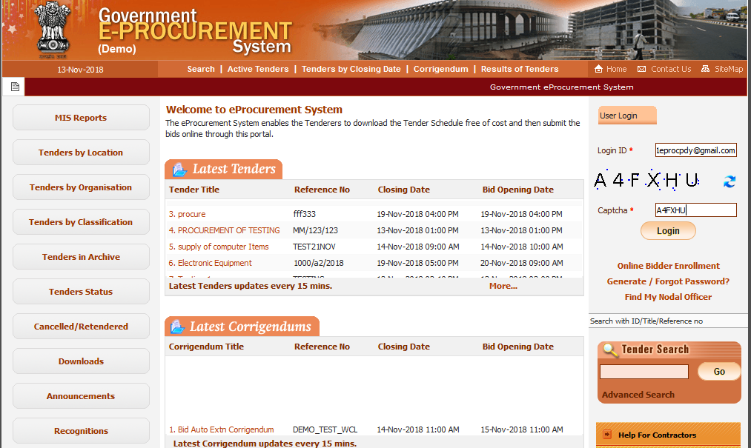
Fill Tender Evaluator ID, Captcha and Click on Login button

Slide 3
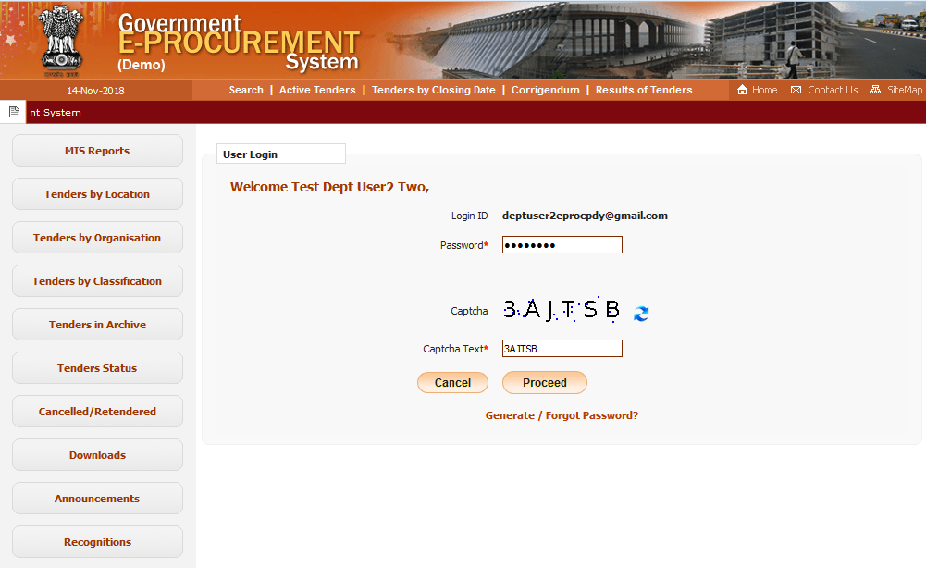
Fill Password, Captcha and Click on Proceed button

Slide 4
Click for Second level Authentication

Slide 5
Enter DSC Password and Click on OK button

Slide 6
Role Based (Procurement Officer Admin(Creator) / Publisher / Opener / Evaluator) Dashboard will appear.

Slide 7
Click on Technical Evaluation link

Slide 8
To be evaluated tenders listed here

Slide 9
Click on View Icon against the corresponding tender

Slide 10
Select Status from the dropdown as Accept or Reject

Slide 11
Fill reasons in the box
Click on Submit Button

Slide 12
Select Committee Chairperson Type
Fill Committee Chairperson Name and Committee member's names

Slide 13
Click on the Browse Icon to Upload Technical Evaluation Summary document
Select File and click on Open Button

Slide 14
Click on Icon to digitally sign the document

Slide 15
Click on Ok Button

Slide 16
Select date for Financial Bid Opening

Slide 17
Select time(hr) for Financial Bid Opening

Slide 18
Select time(min) for Financial Bid Opening

Slide 19
Click on Save Button

Slide 20
Technical Evaluation Details displayed
Click on the Link to Print Technical Evaluation Summary

Slide 21
Technical Evaluation Summary

Slide 22
Technical Bid Evaluation Ends

