Slide 1
Tender Publishing

Slide 2
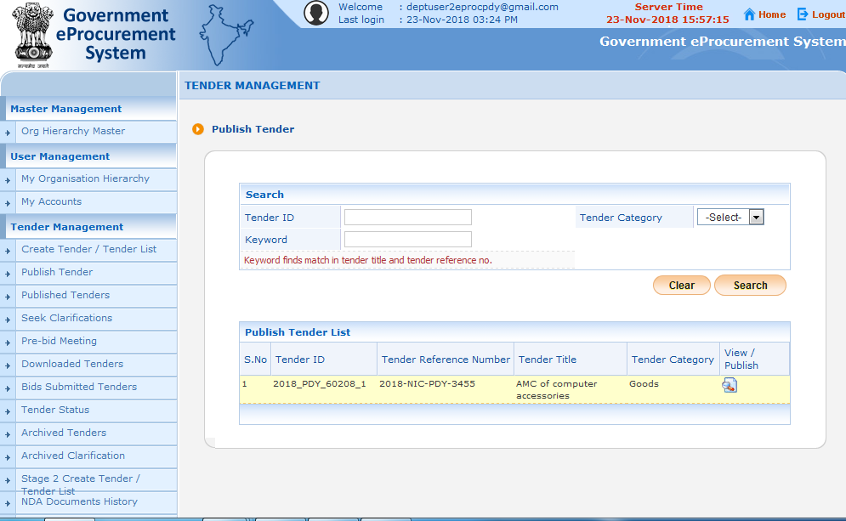
Click “Publish Tender” tab
Click “View” icon to view the full tender details

Slide 3
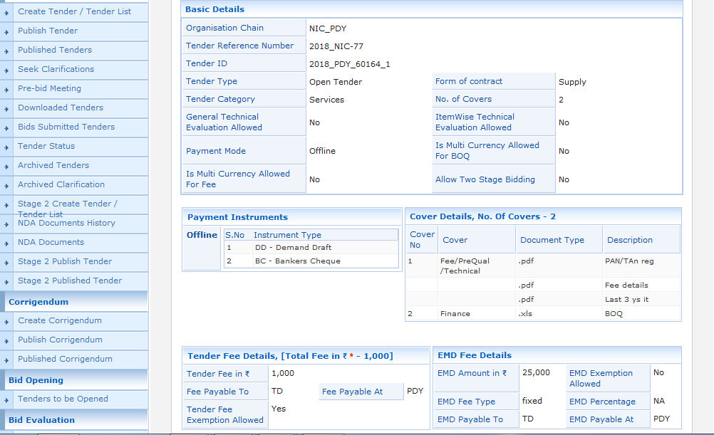

Slide 4
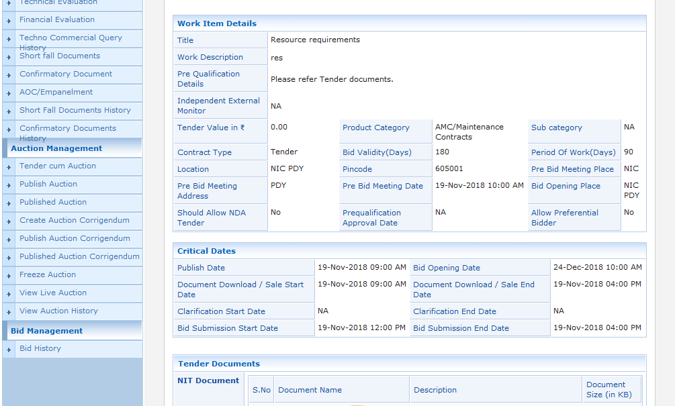

Slide 5
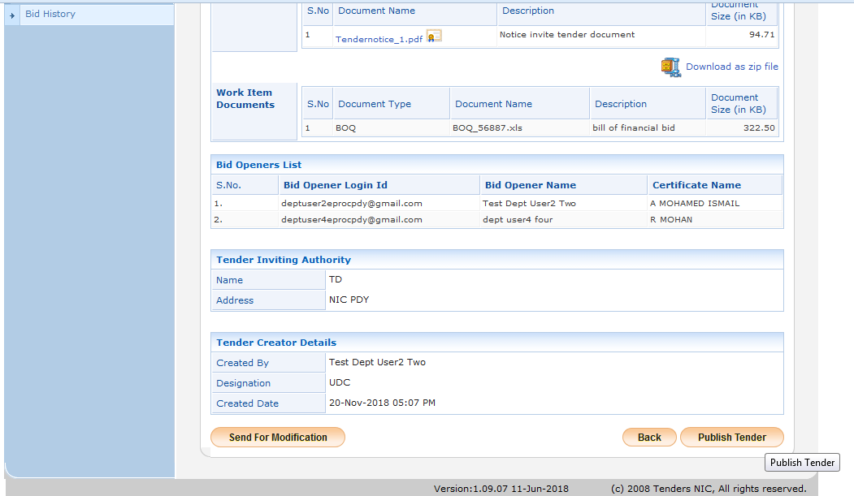
Click “Publish Tender” button to Publish the tender

Slide 6
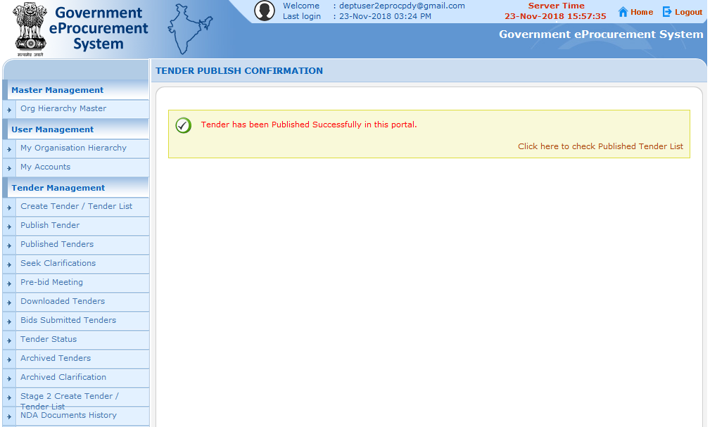
Published Tender Successful message displayed

Slide 7
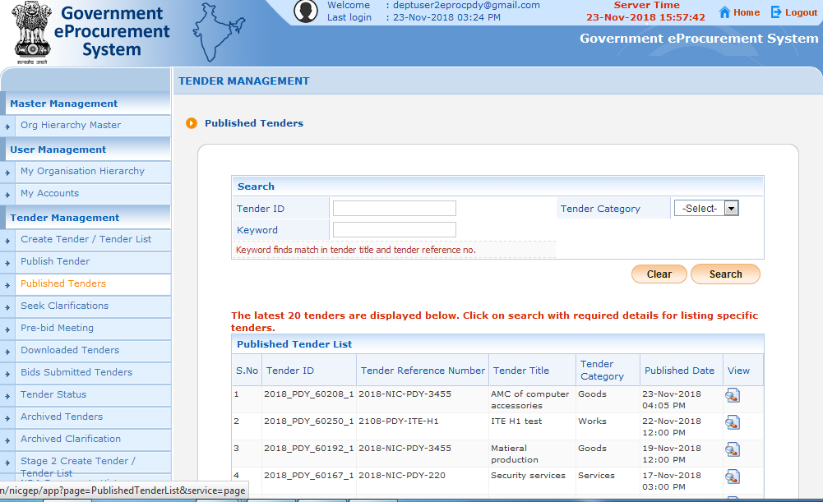
Click “Published Tender” tab

Slide 8
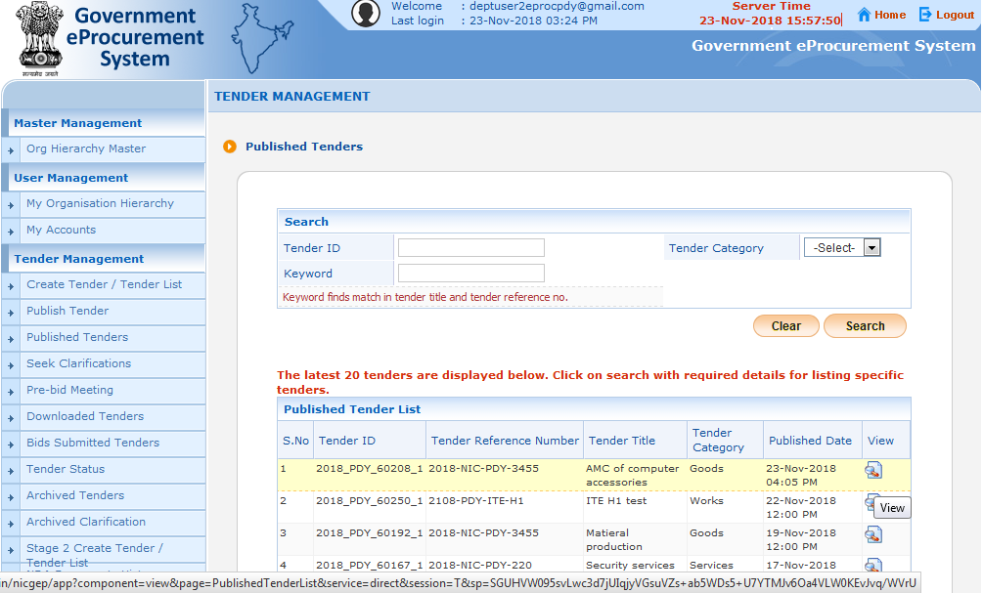
Published Tender displayed in the list

Slide 9
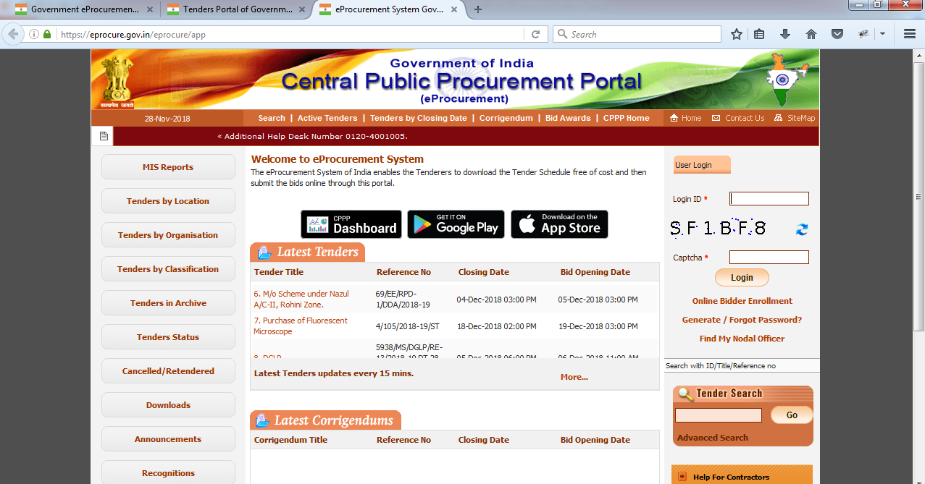
Published Tender scrolled in the home page

Slide 10
Tender Publishing ends

